Slide 1

Welcome to UWE CTF Falcons BootCamp

Slide 2




Let’s get everyone signed up!
Tryhackme – tryhackme.com
HackTheBox – HackTheBox.com
CTFTime – CTFTime.org
Falcons Github – Github.com
Notes:
Our first goal is to bridge the gap between what we get taught in the classroom and what we are expected to know and be able to do in order to work in industry. To this end, we will be running three internal CTFs this year, the winners of which will receive CompTIA Security+ and Pentest+ vouchers, as well as bringing our very own guest speakers in to provide insight into what life in industry is like, and what we can do to become as desirable as possible for employers.
Our first CTF is on November 2nd, it is dubbed "First responders" and is focused on Digital Forensics and Incident Response. We will be running bootcamps every Wednesday until that point in order to help prepare everyone to take part.
Our first guest speaker is Harvey Keane, UWE alumn, Falcons member and BAE employee. He got recruited after winning the BAE CTF and will be talking to us about life after uni on October 23rd
Some people raised the question of getting insight from industry during last week's APT. We’ll not only have guest speakers in to discuss their perspectives, but we also have a card game that has been used in industry to explain and detail the relationship between the financial side of things and the cyber side of things.
Our second goal is to provide a diverse and inclusive environment for students to find peers they can bounce ideas off of, and friends they can go through thick and thin with. As such, we will be hosting a variety of social events, including but not limited to: movie nights, pool nights and touching grass.
2 hours from now, we’ll be hosting our second taster session in the Student Union’s meeting room 1, after which we will convene in the Student Union bar to celebrate having survived freshers another year, to welcome new members and say goodbye to graduating ones.

Slide 3

More Boring Admin Stuff!!!
Society Elections
Open Roles: Social Events Officer
Society Secretary
Freshers Experience Officer
To apply email us at contact@ctffalcons.com
With the subject header Falcons Committee Application.
By the 23rd of October ‘24.
Elections will be scheduled at an EGM on or around the 1st of Nov.

Slide 4
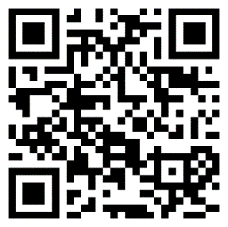
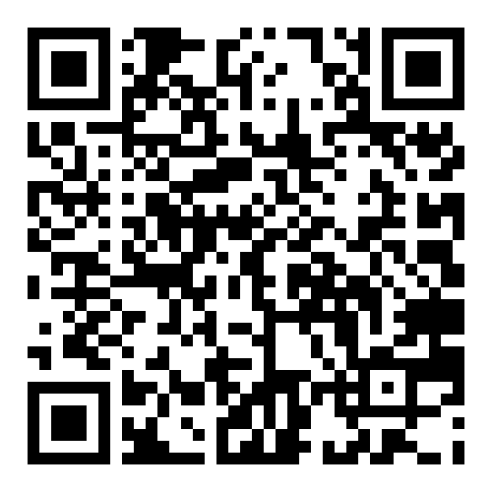
How to Join Us!!!!
UWE Falcons Website
SU Membership Portal

Slide 5
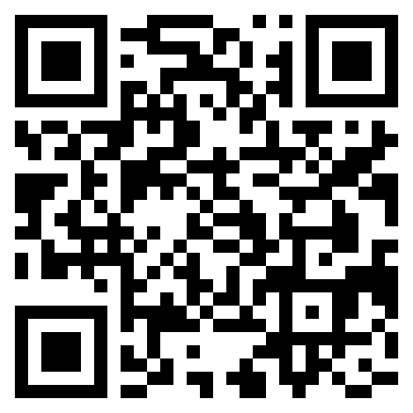

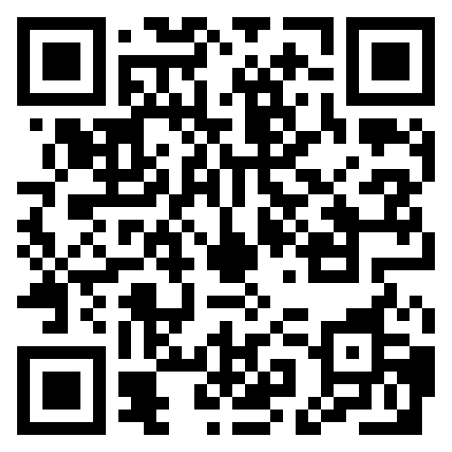
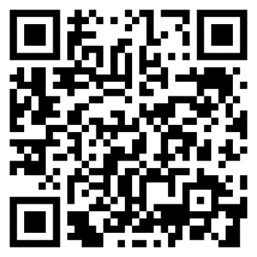
CyberWomen Groups Website
UWE CTF Falcons Website
CyberWomen@UWE LinkedIn
UWE CTF Falcons LinkedIn

